Slide 1
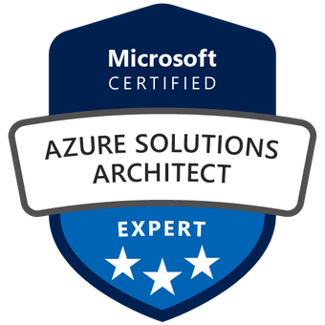
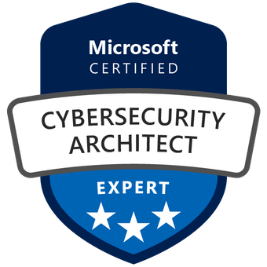
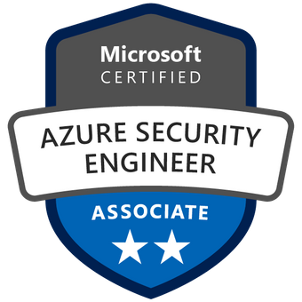

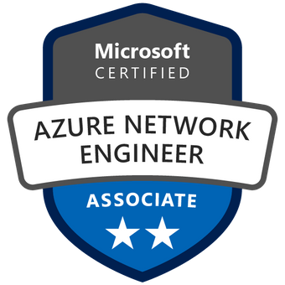
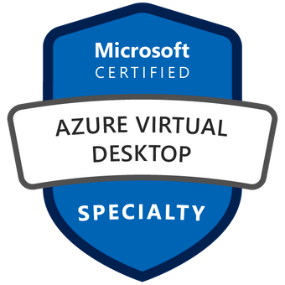
Microsoft Sentinel
The cloud platform for your business
Marco Fekry
Azure Solutions Architect
Microsoft Cybersecurity Architect

Slide 2

IMPORTANCE OF CYBER SECURITY

Slide 3
Attack services are inexpensive
Ransomware:
$66 upfront
Or
30% of the profit (affiliate model)
0days price range varies from $5,000 to $350,000
ATTACKS AGAINST THE PC
ATTACKS AGAINST THE EMPLOYEES AND CUSTOMERS
Loads (compromised device) average price ranges
PC - $0.13 to $0.89
Mobile - from $0.82 to $2.78
Spearphishing services range from $100 to $1,000 per successful account take over
Denial of Service (DOS) average prices
day: $102.05
week: $327.00
month: $766.67
Compromised accounts As low as $150 for 400M. Averages $0.97 per 1k.
SERVICES AIDING THE “CASH OUT”
Proxy services to evade IP geolocation prices vary
As low as $100 per week for 100,000 proxies.
ATTACKER
INFRASTRUCTURE
COLLECTIVE KNOWLEDGE
Notes:
Key Takeaway: Dark Market Products are notably inexpensive with a few exceptions (like zero days)
This is a sampling of price ranges to give you a sense of what is traded and how much it costs. Like any other market, the prices vary because of supply, demand, and externalities like war/politics/etc.
0Day / Zero Day Exploits are quite expensive, costing as much as $350,000 USD for higher value vulnerabilities. (Zero-Day vulnerabilities are unpatched and otherwise unknown vulnerabilities). The price varies by many factors including ease of exploitation, affected platforms, and exclusivity of use.
CLICK 1
RATs range from free to premium pricing of about $2,000 USD
Loads are compromised PCs or mobile devices that can be taken over by the buyer on a temporary or permanent basis and cost pennies up to a dollar for PCs and a few dollars for mobile devices.
CLICK 2
[Distributed] Denial of Service (DOS / DDoS) attack services are focused on slowing or taking down target services or websites. There are many price variables, but average monthly rate is less than $1,000 USD
Proxy services allow an attacker to route traffic through a local IP address range to defeat blocking of traffic from their country.
CLICK 3
Ransomware is sold as a kit and is also offered in an affiliate model where the kit maker takes a percentage of the ransomware profit of the attack.
Spearphishing is usually priced by successful account takeover and costs between USD $100 and $1000
Compromised accounts usually come in bulk in very large blocks. Prices average around $1 USD per 1k accounts and quality varies significantly (from 0.1% up to 20% of the username/password pairs may be valid)
This is a snapshot of the averages, the prices fluctuate up and down but you now have an idea of what can be bought/sold at what price.
Additional Information
This cheapness of resources make the attacker ROI equation quite favorable.
This is partially offset by the speculative nature of attacks (not all pay off) and the risk of illegal activities (jails/fines/etc.), but it remains an incredibly lucrative opportunity space for criminals.

Slide 4
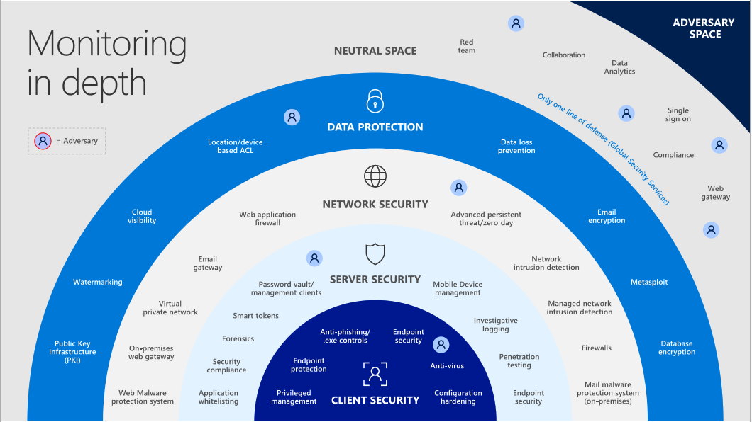

Slide 5
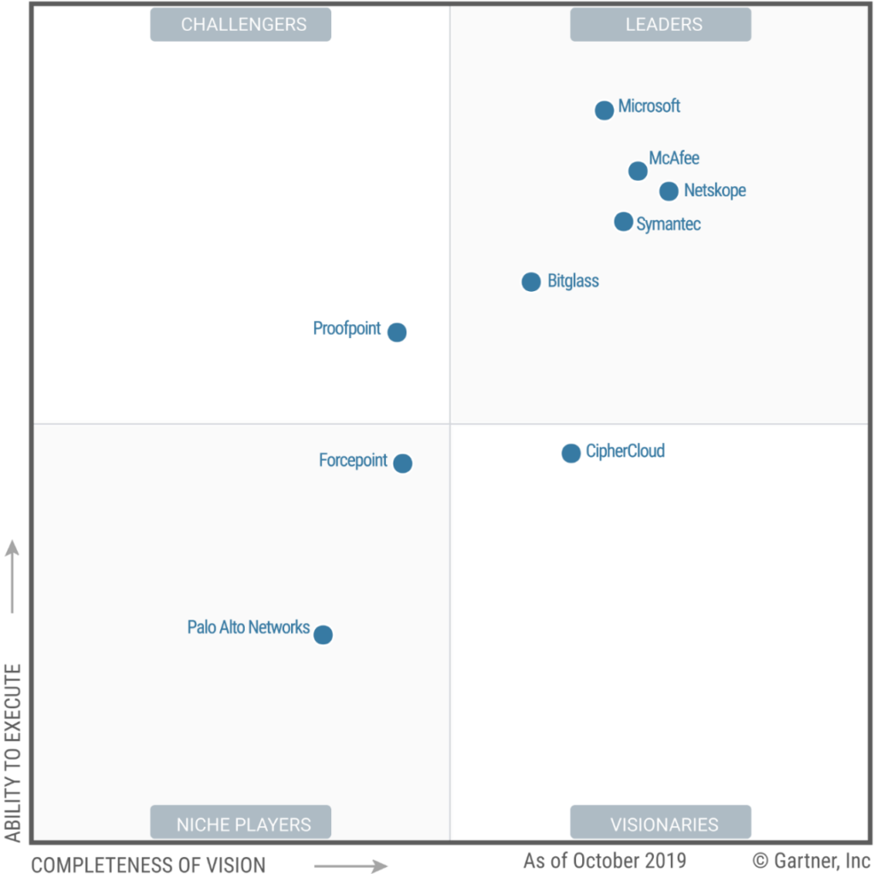
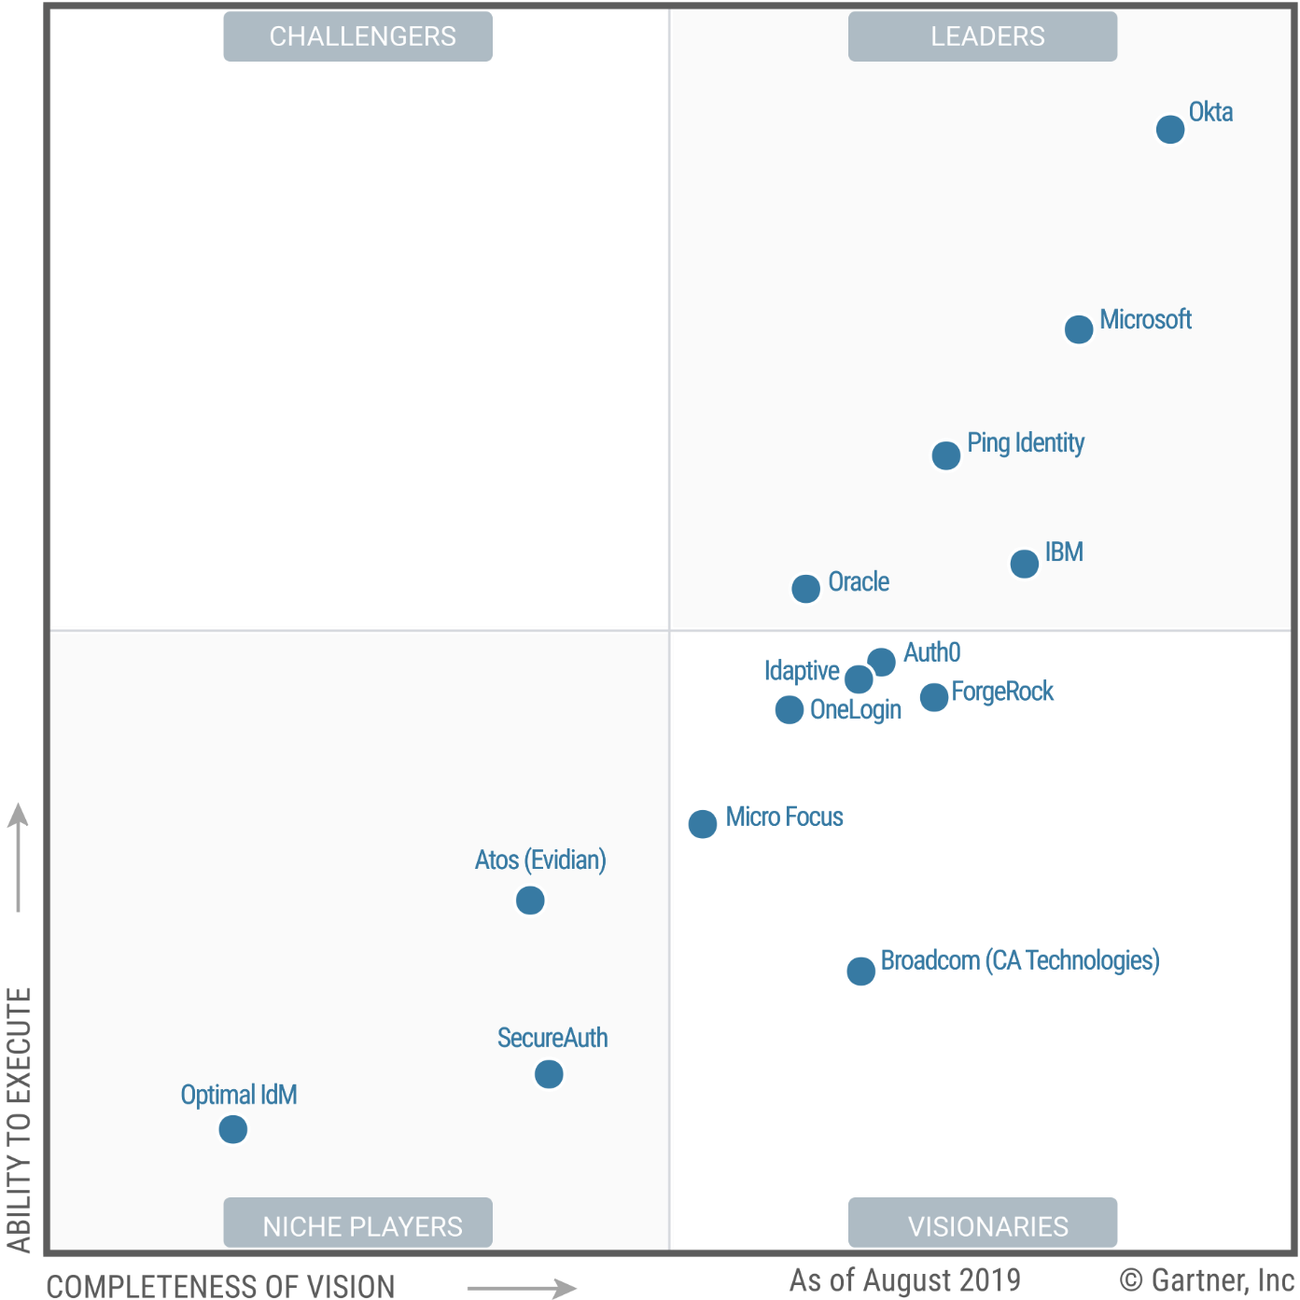
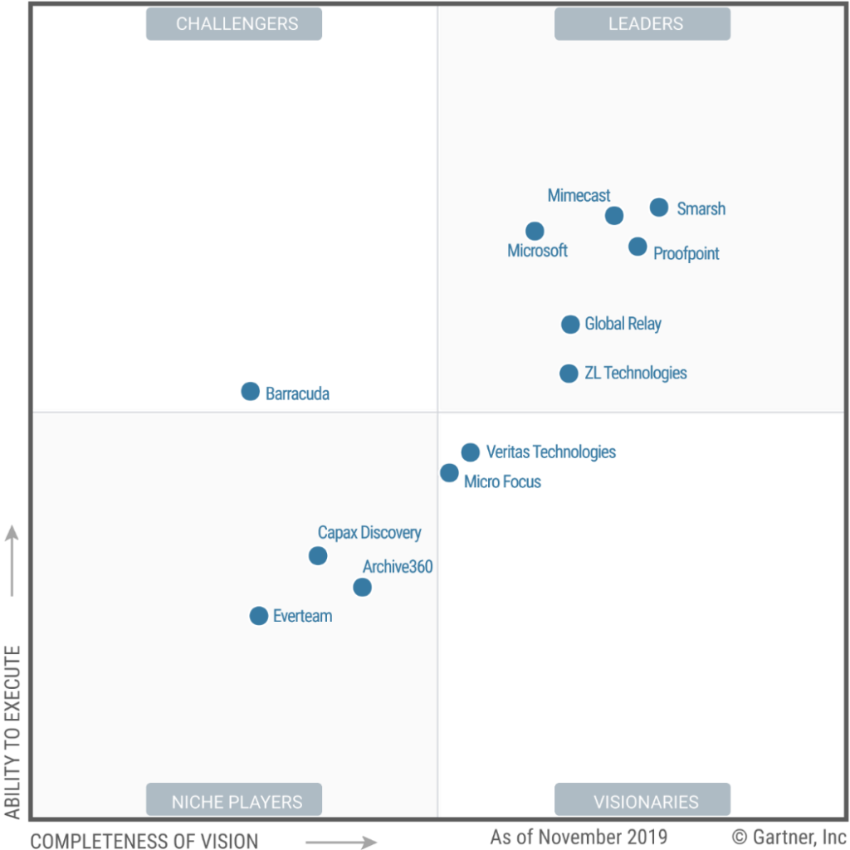
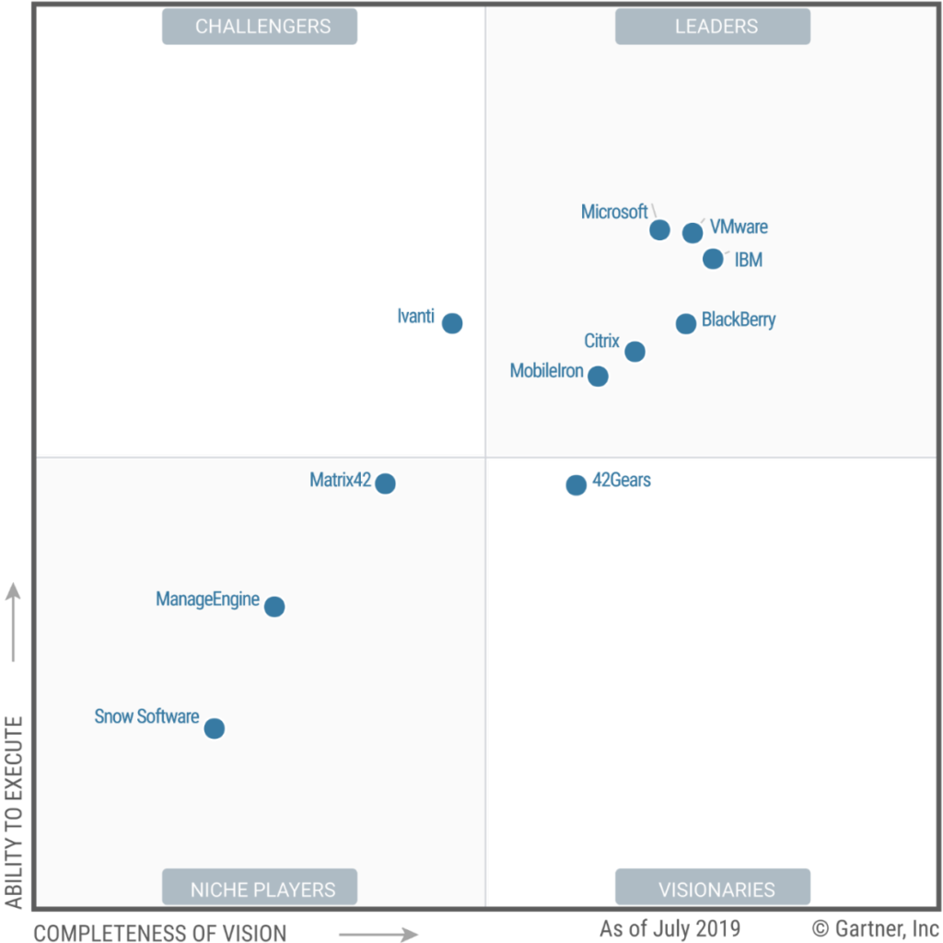
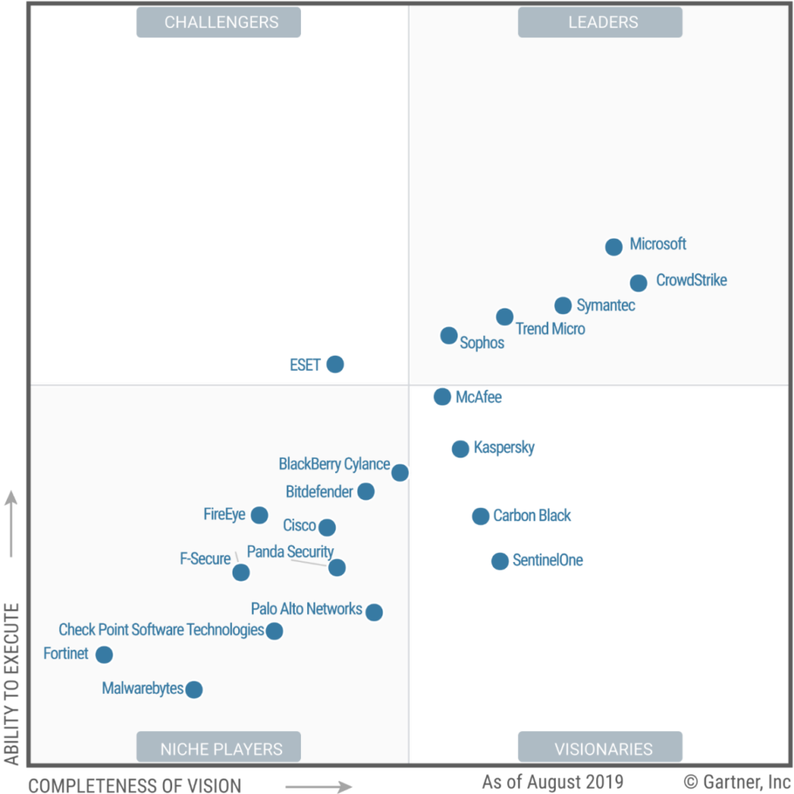
Microsoft Security—a Leader in 5 Gartner Magic Quadrants
Cloud Access Security Broker (CASB) solutions
Access Management
Enterprise Information Archiving
Unified Endpoint Management (UEM) tools
Endpoint Protection Platforms
Microsoft Security doesn’t just deliver strong security products in five crucial security areas only. We provide a comprehensive set of security solutions that are built to work together, from identity and access management to threat protection to information protection and cloud security.
A Leader in CASB
A Leader in Access Management
A Leader in Enterprise Information Archiving
A Leader in Endpoint Management (UEM)
A Leader in Endpoint Protection Platforms

Slide 6














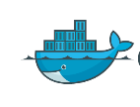


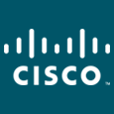

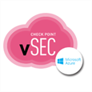



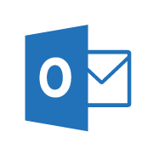

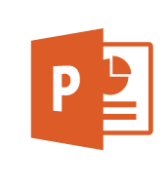
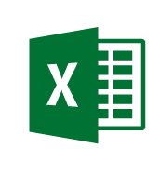

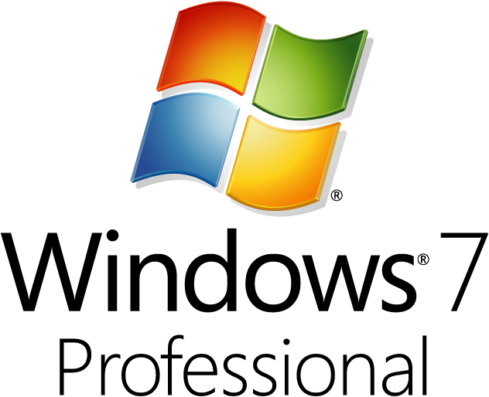
Cybersecurity Reference Architecture
Software as a Service
Office 365
80% + of employees admit using non-approved SaaS apps for work (Stratecast, December 2013)
ASM
Vulnerability Management
Security Operations Center (SOC)
Incident
Response
Security Development Lifecycle (SDL)
Investigation
and Recovery
Lockbox
Logs & Analytics
Internet of Things
Active Threat Detection
Unmanaged & Mobile Clients
Identity & Access
Information
Protection
Managed Security Provider
UEBA
ATA
Hunting Teams
Enterprise Threat Detection
Azure Active Directory
Analytics
OMS
Cloud App Security
SIEM
PADS
Conditional Access
Intune MDM/MAM
Azure AD
Identity Protection
Office 365 DLP
Extranet
SIEM Integration
On Premises Datacenter(s)
Edge DLP
Express
Route
NGFW
Colocation
Security Appliances
Microsoft Azure
Azure AD PIM
Azure
Information Protection (AIP)
Classify
Label
Protect
Report
SSL Proxy
Office 365 ATP
Email Gateway
Anti-malware
IPS
Multi-Factor Authentication
Azure Security Center
Threat Protection
Threat Detection
VPN
Hello for Business
Azure Key Vault
Classification Labels
Enterprise Servers
Hold Your Own Key (HYOK)
Shielded VMs
Windows Server 2016 Security
Shielded VMs, Device Guard, Credential Guard, Just Enough Admin, Hyper-V Containers, Nano server, …
Azure App Gateway
MIM PAM
VMs
VMs
Azure Antimalware
ATA
Domain Controllers
Network Security Groups
Active
Directory
ESAE Admin Forest
VPN
Structured Data & 3rd party Apps
Privileged Access Workstations (PAWs)
Endpoint DLP
$
Managed Clients
SQL Encryption & Firewall
Certification Authority (PKI)
Windows Info Protection
Legacy Windows
Windows 10
Device Health Attestation
Remote Credential Guard
Sensitive
Workloads
Windows 10 Security
Secure Boot
Device Guard
Application Guard
Credential Guard
Windows Hello
Disk & Storage Encryption
WEF
Mac
OS
EDR - Windows Defender ATP
IoT
DDoS attack mitigation
Nearly all customer breaches that Microsoft’s Incident Response team investigates involve credential theft
63% of confirmed data breaches involve weak, default, or stolen passwords (Verizon 2016 DBR)
EPP - Windows Defender
System Center Configuration Manager + Intune
Backup and Site Recovery
Last updated March 2017 – latest at http://aka.ms/MCRA

Slide 7

IT deployment &
maintenance
History of threats
Environmental
Changes
44% of alerts are
never investigated
Security operations challenges
Too many disconnected
products
3.5M unfilled security
jobs in 2021
Lack of automation
*ESG: Security Analytics and Operations: Industry Trends in the Era of Cloud Computing 2019
Notes:
The SecOps mission of protecting organizations’ information and assets is becoming increasingly difficult. Attack techniques, frequency, and complexity are evolving fast. Security teams are under strain from the expanding breadth of defensive technologies, accelerating hybrid cloud adoption, and borderless, zero-trust networks. The shortage of SecOps talent makes this problem worse.
Considering the future needs of SOCs, these are the most prominent pain points:
Threats continue to grow in complexity and volume
Attacks are increasingly heterogeneous. A typical attack spans different parts of the enterprise and crosses various resource types: it might start from an IoT device, proceed to an endpoint, spread to a cloud service or to a database, involve multiple user accounts or tenants, and so on.
Alert fatigue: SOCs see too many alerts from disconnected products
Enterprise SOCs typically have dozens of security products, each producing a large volume of alerts. In isolation, these products often have high false positive rates and poor response prioritization, resulting in deafening alert noise. Attacks fall through the cracks despite generating alerts. Unfortunately, legacy SIEMs are functioning only as aggregators and don’t increase response capabilities. Enterprise SOCs need a way to integrate their security products to reduce the noise, prioritize alerts, and enable investigation and hunting across the entire dataset.
There is a global shortage of security analysts and experience
The need for skilled security professionals has greatly increased, and supply cannot meet current or future demand. A recent report by CSO magazine showed that this global talent shortage will increase to 3.5 million unfilled security jobs by 2021.
Investigation is complex and time-consuming
Every second counts when SecOps personnel are handling a threat that might jeopardize their organization. The clock is ticking fast, but investigation requires highly skilled security analysts and can often take days or weeks.
Current solutions are not architected for today’s demands, or tomorrow’s
Legacy on-premises SIEMs require powerful hardware and extensive maintenance that make them expensive to operate. Storage and compute needs increase dramatically during an incident, which is difficult for an on-prem footprint to accommodate. The move to the cloud has enabled a new degree of enterprise scale-out, and with the explosion of cloud-born data, legacy SIEMs are less and less able to cope with the demand.

Slide 8
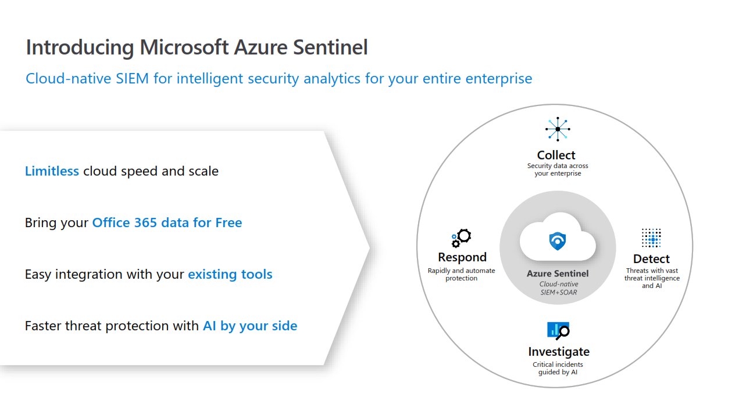

Slide 9
Visibility and collection

Slide 11

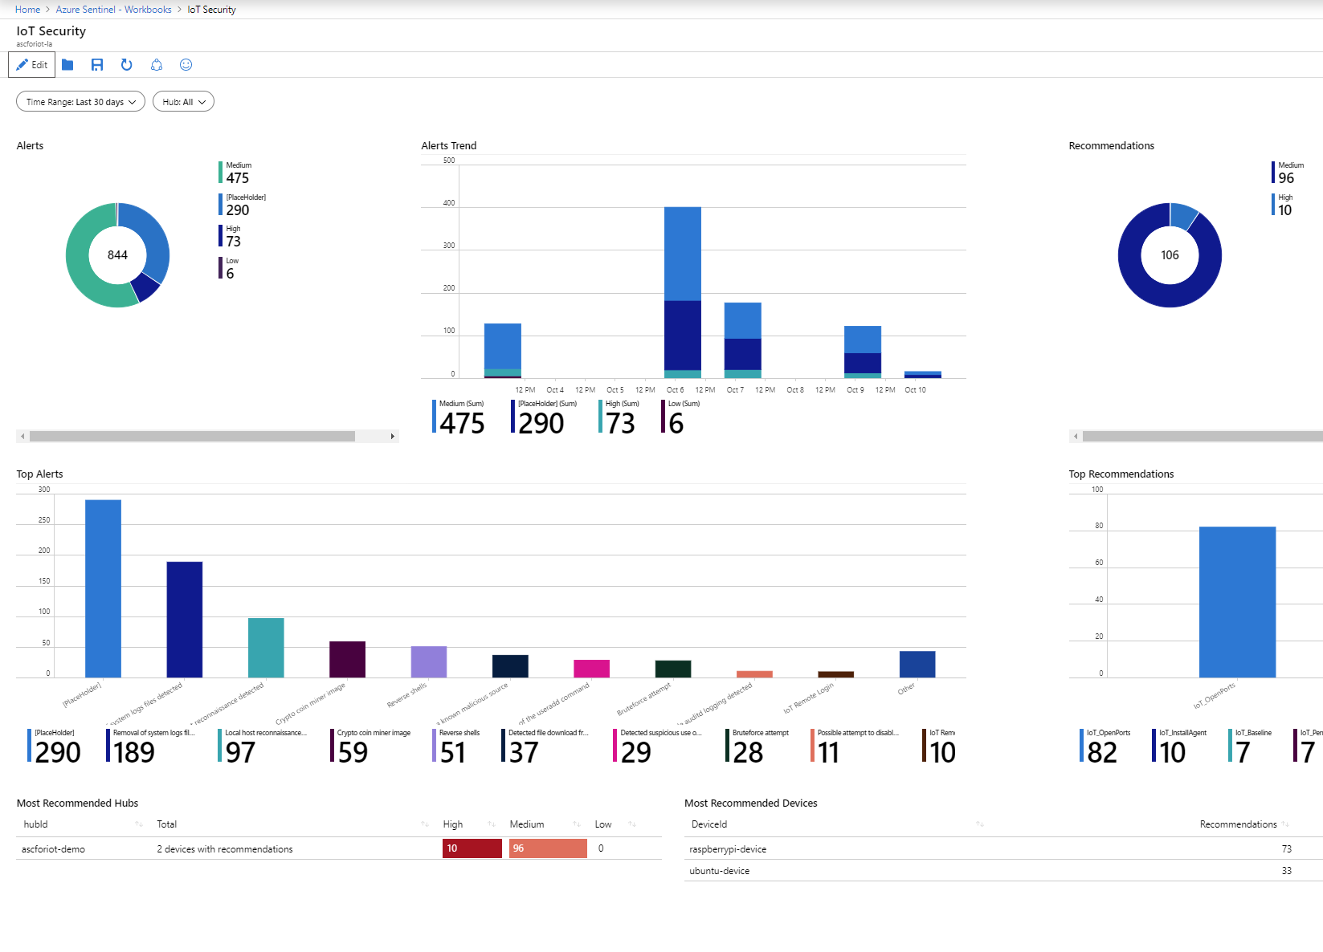
Use workbooks to power interactive dashboards
2
Choose from a gallery of workbooks
Customize or create your own workbooks using queries
Take advantage of rich visualization options
Gain insight into one or more data sources
Notes:
After you connected your data sources to Azure Sentinel, you get instant visualization and analysis of data so that you can know what's happening across all your connected data sources, it enables interactive dashboards customized to your needs. Azure Sentinel gives you workbooks that provide you with the full power of tools already available in Azure as well as tables and charts that are built in to provide you with analytics for your logs and queries. You can either use built-in workbooks or create a new workbook easily, from scratch or based on an existing workbook.
Interactive dashboards
Combines multiple kinds of visualizations – including graphs and maps
Provides deep insights into a single data source or combining multiple sources
Powered by KQL queries, making workbooks easy to build and customize

Slide 12
Analytics

Slide 13
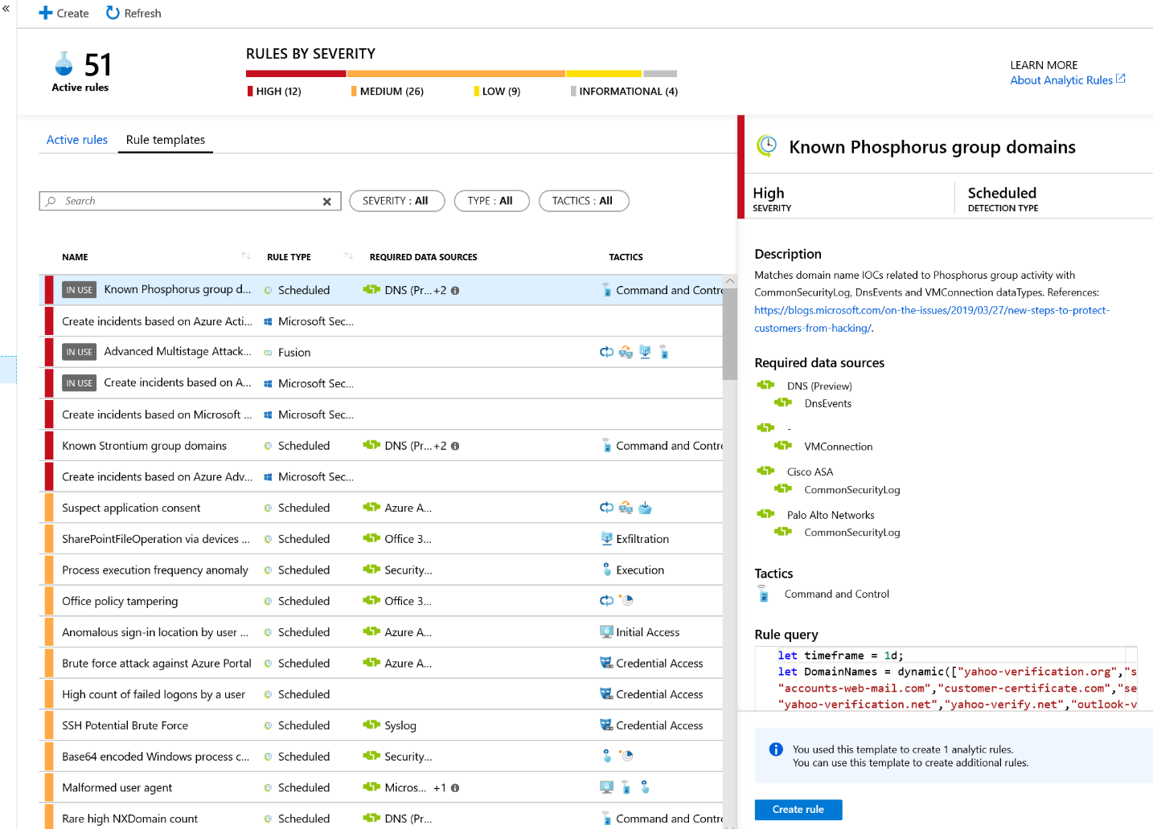
Leverage analytics to detect threats
3
Choose from more than 100 built-in analytics rules
Customize and create your own rules using KQL queries
Correlate events with your threat intelligence and now with Microsoft URL intelligence
Trigger automated playbooks
Notes:
After you connect data sources to Azure Sentinel, the next step is to identify suspicious activities and threats. Azure Sentinel provides built-in templates to enable you to do this and get notified of such threats. These templates were designed by Microsoft’s team of security experts and analysts based on known threats, common attack vectors, and suspicious activity escalation chains. After you enable these templates, they will automatically search for suspicious activity across your environment. Many of them can be customized to search for, or filter out, activities according to your needs.
More than 100 built-in alert rules were developed by Microsoft and community security experts
A wizard enables you to create your own analytics rules using KQL queries
Thresholds can be set to alert when activity levels exceed normal patterns
Correlation events with your threat intelligence and now with Microsoft intel about malicious URLs.
Microsoft has unparalleled view of evolving threat landscape
Customers can now match Microsoft URL TI with network logs
Matched MS indicators are added to the TI table for use like any other indicator
Retrospective lookbacks that match TI against historical event data and more TI types will be coming soon.
Alerts can be used to trigger automated playbooks

Slide 14
Hunting

Slide 15
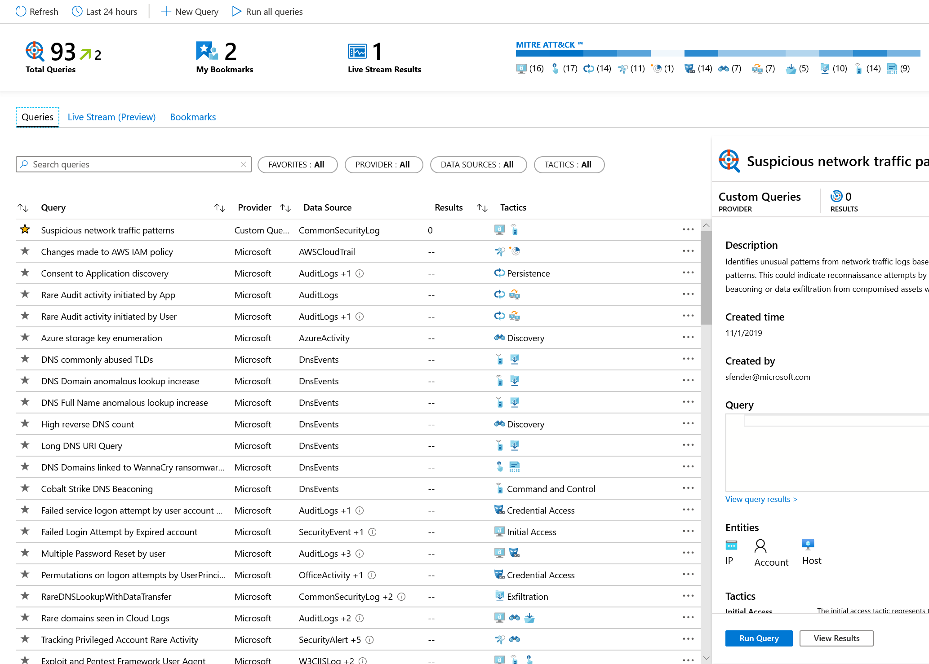
Start hunting over security data with fast, flexible queries
4
Run built-in threat hunting queries - no prior query experience required
Customize and create your own hunting queries using KQL
Integrate hunting and investigations
Notes:
Analysts need to proactively look for threats that may not have been discovered by security apps. Azure Sentinel includes built-in hunting queries that guide you to ask the right questions to find previously undiscovered threats.
With Azure Sentinel hunting, you can take advantage of the following capabilities:
• Built-in queries: A starting page provides preloaded query examples designed to get you started quickly and familiarize you with the tables and the query language. These built-in hunting queries are developed and fine-tuned by Microsoft security researchers and the GitHub community on a continuous basis to provide you with an entry point and help you start hunting for the beginnings of new attacks.
• Powerful query language with IntelliSense: Built on top of a query language, this gives you the flexibility you need to take hunting to the next level.
.• Use notebooks to automate investigation: Notebooks encapsulate all the hunting steps in a reusable playbook that can be shared with others in your organization.
• Query the stored data: The data is accessible in tables for you to query. For example, you can query process creation, DNS events, and many other event types.
• Links to community: Leverage the power of the greater community to find additional queries and data sources

Slide 16
Incidents

Slide 17
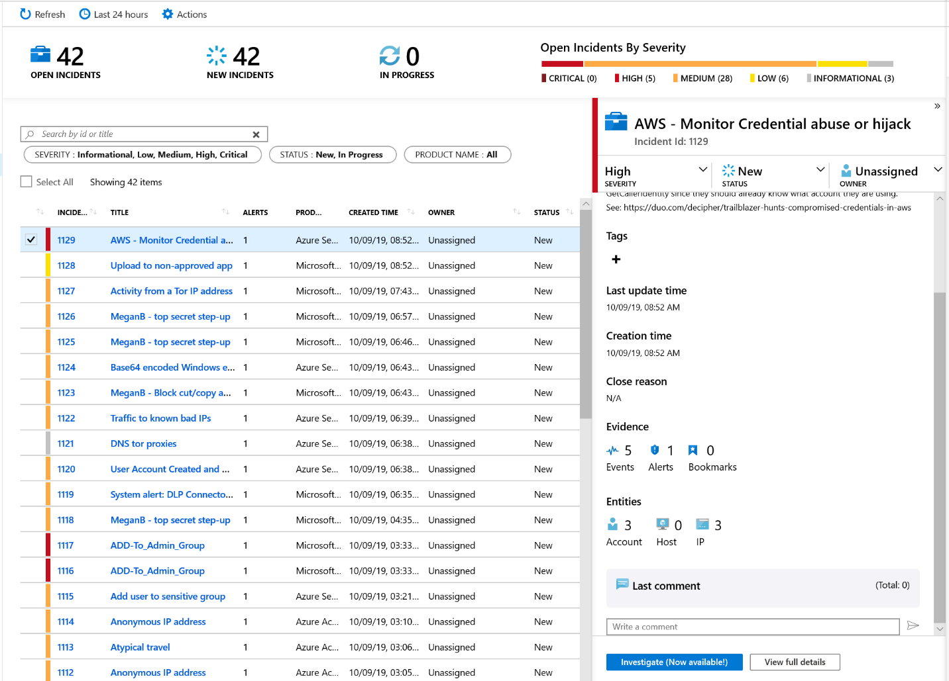
Start and track investigations from prioritized, actionable security incidents
5
Use incident to collect related alerts, events, and bookmarks
Manage assignments and track status
Add tags and comments
Trigger automated playbooks
Notes:
Azure Sentinel lets you create advanced alert rules, that generate incidents that you can assign and investigate. It gives you a prioritized list of alerts to formulate your incident response. An incident is created based on analytic rules that you created in the Analytics page. The properties related to the alerts, such as severity, and status, are set at the incident level. After you let Azure Sentinel know what kinds of threats you're looking for and how to find them, you can monitor detected threats by investigating incidents.
You can complete the following tasks quickly:
Monitor for alerts, events, and bookmarks related to a particular security threat, Automatically created from alerts or initiated by a security analyst when threat hunting
Assign to analysts for further investigation and status can be tracked
Analysts can easily tag incidents and add comments
Trigger automated playbooks from incidents

Slide 18
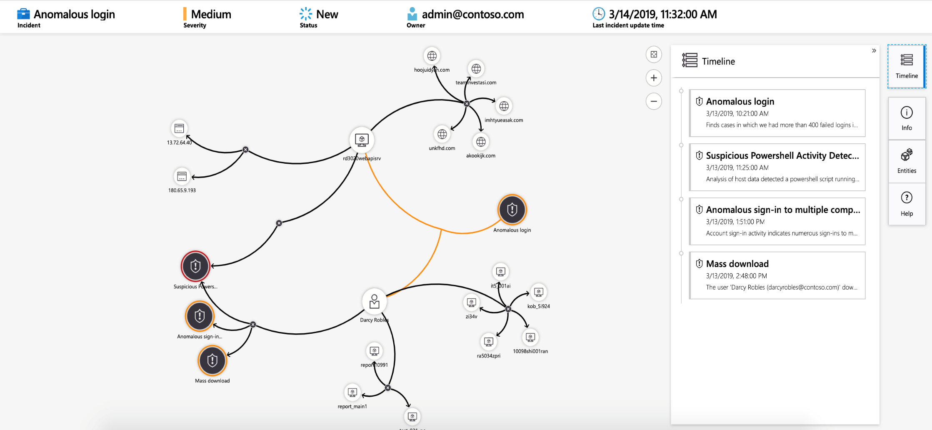
Visualize the entire attack to determine scope and impact
6
Navigate the relationships between related alerts, bookmarks, and entities
Expand the scope using exploration queries
View a timeline of related alerts, events, and bookmarks
Gain deep insights into related entities – users, domains, and more
Notes:
Graphical and AI-based investigation will reduce the time it takes to understand the full scope of an attack and its impact. The investigation graph enables analysts to ask the right questions for each investigation. The investigation graph helps you understand the scope, and identify the root cause, of a potential security threat by correlating relevant data with any involved entity. You can dive deeper and investigate any entity presented in the graph by selecting it and choosing between different expansion options.
The investigation graph provides you with:
Visual context from raw data: The live, visual graph displays entity relationships extracted automatically from the raw data. This enables you to easily see connections across different data sources.
Full investigation scope discovery: Expand your investigation scope using built-in exploration queries to surface the full scope of a breach.
Built-in investigation steps: Use predefined exploration options to make sure you are asking the right questions in the face of a threat.

Slide 19
Automation

Slide 20
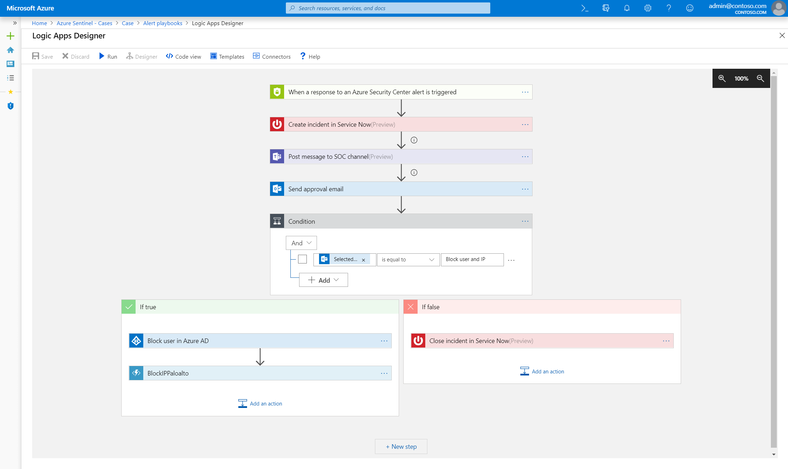
Automate and orchestrate security operations using integrated Azure Logic Apps
10
Build automated and scalable playbooks that integrate across tools
Choose from a library of samples
Create your own playbooks using 200+ built-in connectors
Trigger a playbook from an alert or incident investigation
Notes:
While AI sharpens your focus on finding problems, once you have solved the problem you don’t want to keep finding the same problems over and over – rather you want to automate response to these issues. Azure Sentinel provides built-in automation and orchestration with pre-defined or custom playbooks to solve repetitive tasks and to respond to threats quickly. Azure Sentinel will augment existing enterprise defense and investigation tools, including best-of-breed security products, homegrown tools, and other systems like HR management applications and workflow management systems like ServiceNow:
Powered by Azure Logic Apps and fully integrated with Azure Sentinel
Build automated and scalable playbooks that integrate across tools
Choose from a library of samples or create your own using more than 200+ built-in connectors plus generic connectors like HTTPS
Trigger a playbook from an alert or incident investigation

Slide 23
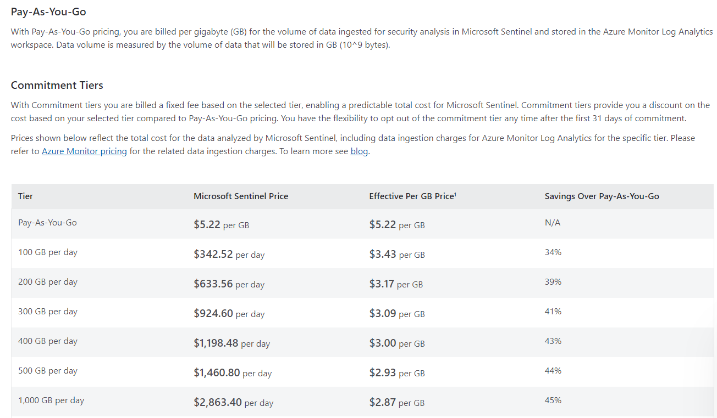
Sentinel Pricing Models

Slide 24
Sentinel Pricing Models
Azure Activity Logs, Office 365 Activity Logs, Alerts from Microsoft Threat Protection are available at no cost.

Slide 25
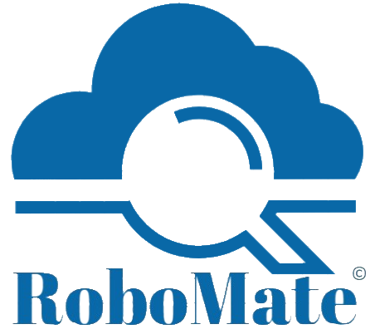
What is RoboMate Cloud Automation?
RoboMate is a UI based cloud automation desktop tool that integrates multiple code languages, providing cloud engineers a day-to-day cloud operation tool supporting Azure , AWS , OCI and Office 365.
RoboMate is designed to assess cloud environments for Resources, Identity & Security, Cost Analysis, Charts and wide options of reports
RoboMate was built to streamline deployment scenarios, with a lot of options using the Cloud Well-Architected Frameworks , Cybersecurity Reference Architectures and Security best practices, with no code skills covering cloud Compute , Networking , Monitoring , Cost and Security..
Notes:
1- Cloud automation desktop tool with friendly UI
2-

Slide 26





Our powerful ability to deploy Microsoft Sentinel
ROBOMATE is an automation tool used to deploy, update and manage production environments in a few clicks
ROBOMATE saves a huge time consuming
ROBOMATE reduces human errors in deploying resources
ROBOMATE minimizes administrative efforts
ROBOMATE has a powerful ability in recommending the best solutions and recommendations upon your needs
ROBOMATE has many architectures and scenarios
Notes:
Azure Sentinel delivers and end-to-end solution for security operations.
Starts with collecting all of your data and getting instant insight into that data via workbooks and queries.
Begin applying analytics to that data to find real threats from that sea of data.
Hunt through all your data using built-in exploratory queries – use bookmarks and live stream tools to track notable events and monitor new activities
Manage and investigate incidents using graphs and timeline views.
Automate investigation and remediation playbooks
All of this is powered by a community of security analysts – AND – backed by Microsoft security experts who leverage their vast experience defending Microsoft services to contribute analytics, queries, playbooks and more

Slide 27
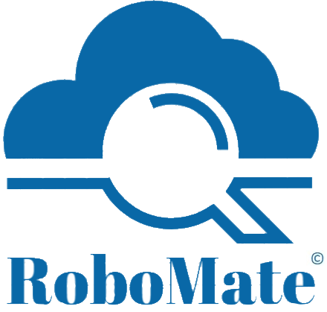
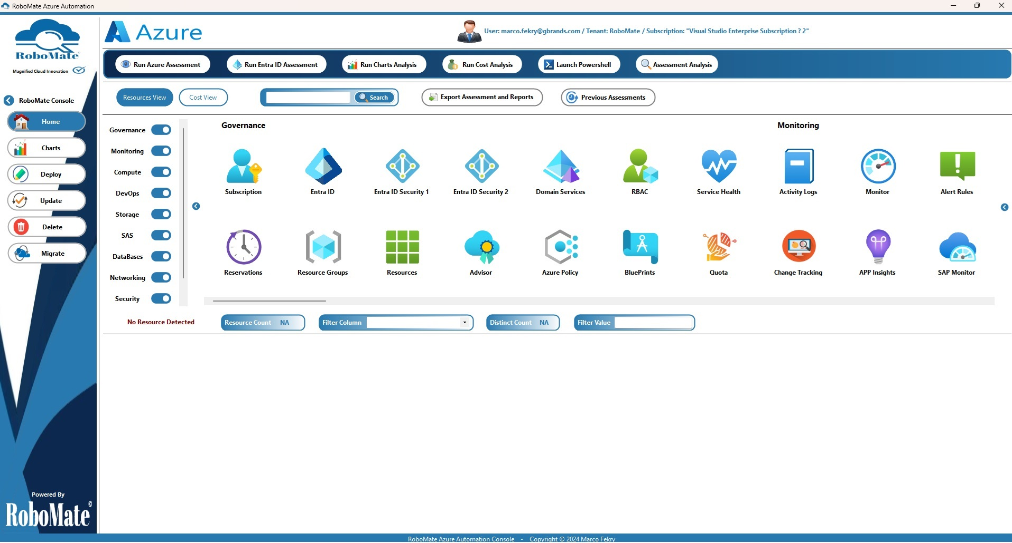
RoboMate Azure Assessment
Notes:
To highlight a few points on this slide:
As I’ve mentioned before, we are global. We support 60+ Azure regions around the world.
We what you to feel protected so we heavily invest in security.
Lastly, we have 93 compliance offerings from certifications to laws we abide by, like GDPR.

Slide 28
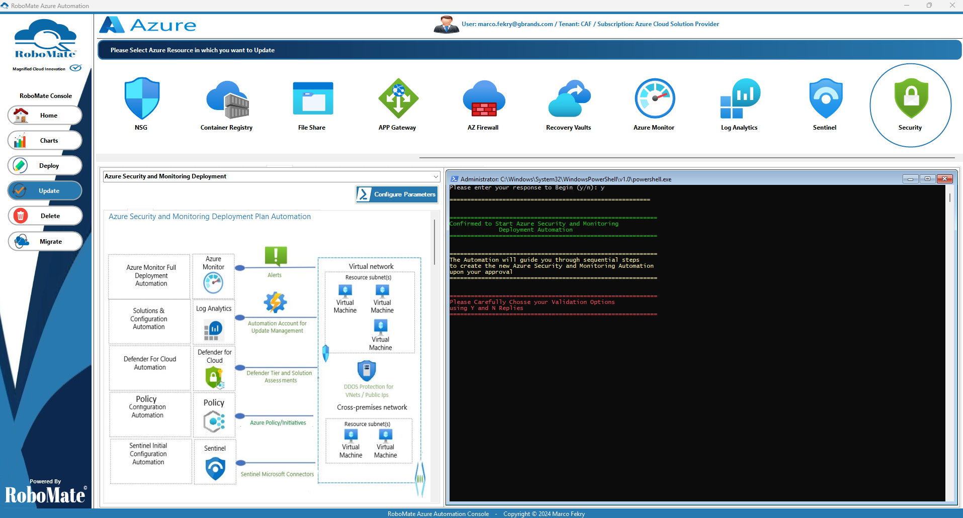
Microsoft Sentinel
Microsoft Sentinel deployment by RoboMate
Notes:
To highlight a few points on this slide:
As I’ve mentioned before, we are global. We support 60+ Azure regions around the world.
We what you to feel protected so we heavily invest in security.
Lastly, we have 93 compliance offerings from certifications to laws we abide by, like GDPR.

Slide 29
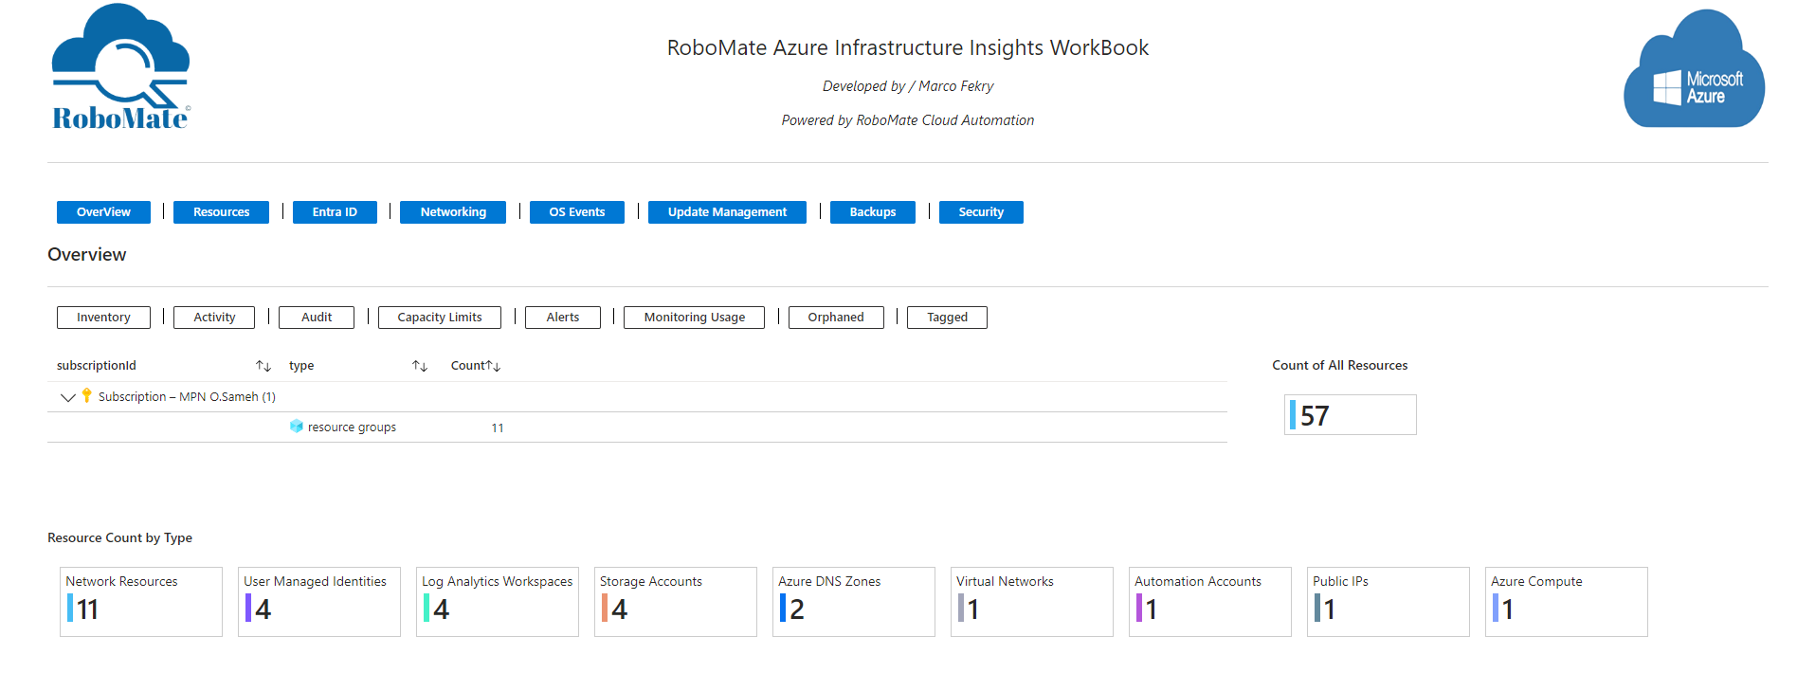
RoboMate Azure Workbook
Notes:
To highlight a few points on this slide:
As I’ve mentioned before, we are global. We support 60+ Azure regions around the world.
We what you to feel protected so we heavily invest in security.
Lastly, we have 93 compliance offerings from certifications to laws we abide by, like GDPR.

Slide 30
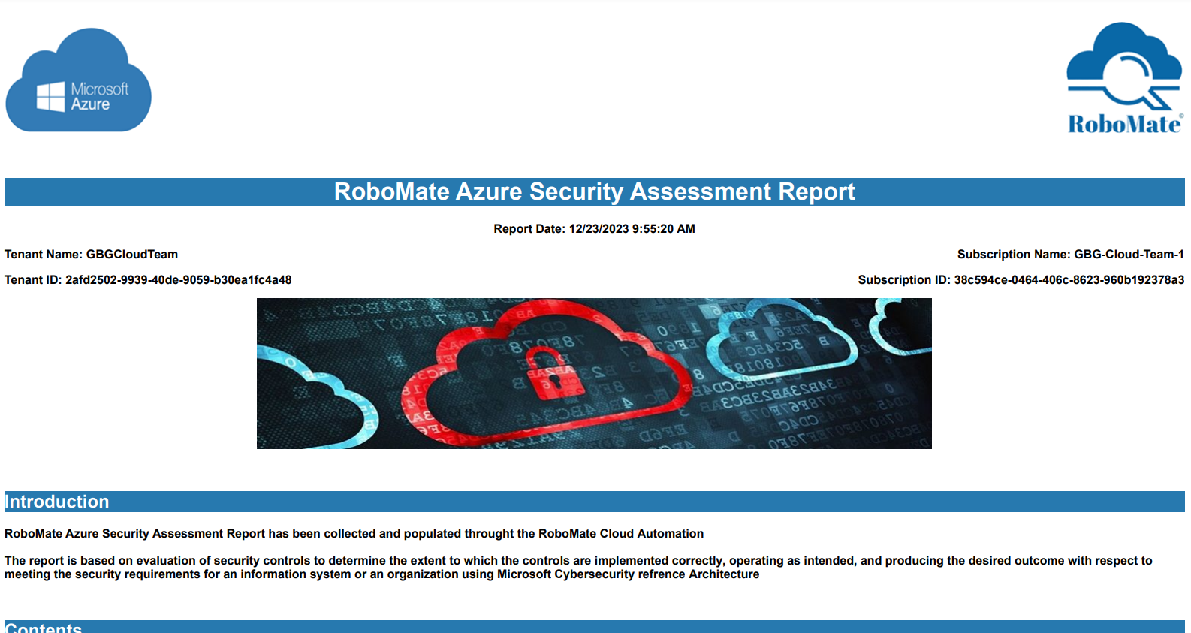
RoboMate Azure Security Assessment Report
Notes:
To highlight a few points on this slide:
As I’ve mentioned before, we are global. We support 60+ Azure regions around the world.
We what you to feel protected so we heavily invest in security.
Lastly, we have 93 compliance offerings from certifications to laws we abide by, like GDPR.

Slide 31
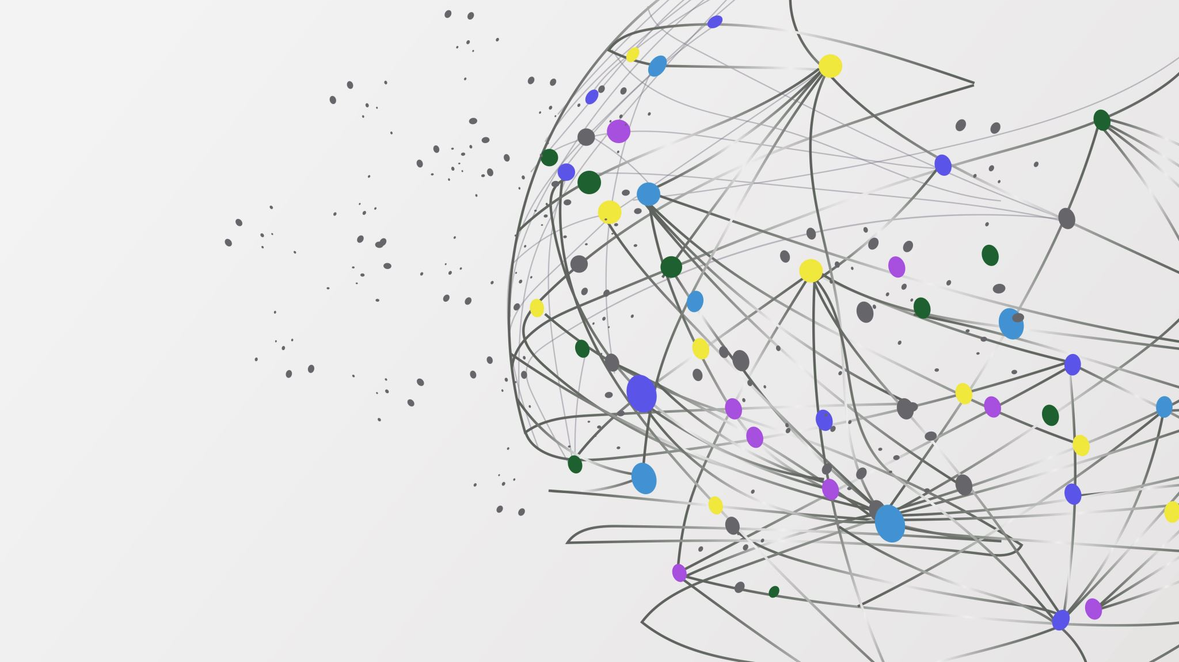
Thanks!

